Slide 1

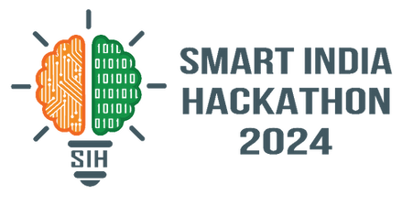

SMART INDIA HACKATHON 2024
Problem Statement ID – 1716
Problem Statement Title- Indian Sign Language to
Text/Speech Translation
Theme - Miscellaneous
PS Category- Software
Team Name – Logicode
Mentor : Dr. Amit Kumar Mishra

Slide 2




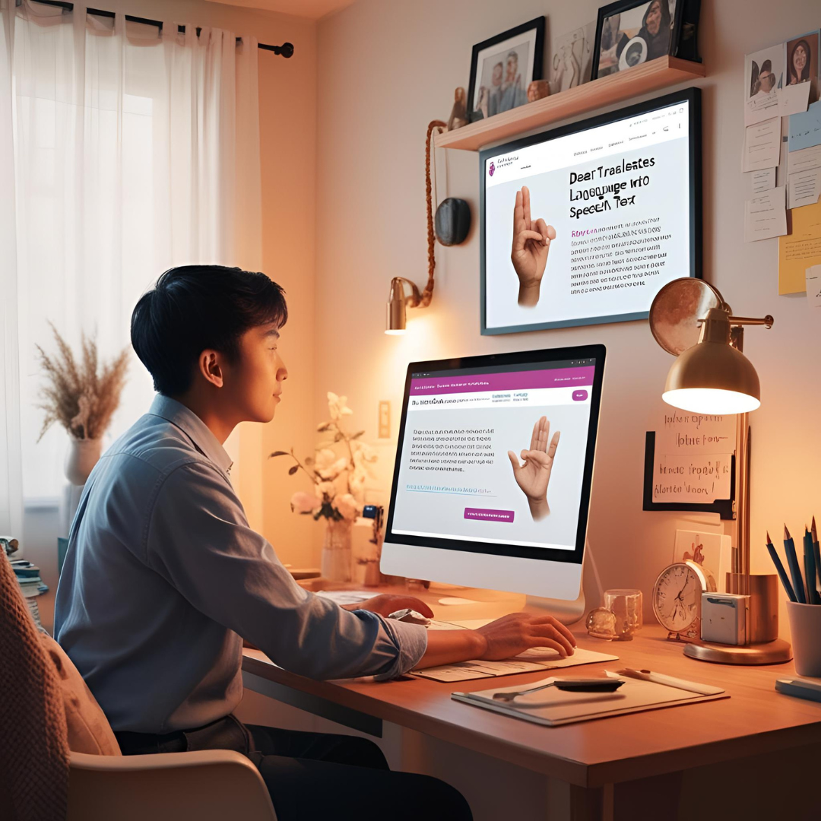
Logicode
Indian Sign Language to Text/Speech Translation
Proposal: The India Sign Language to Text/Speech Translation System uses machine learning and computer vision to convert Indian Sign Language (ISL) gestures into text and speech in real time. It enhances communication for individuals with hearing and speech impairments by ensuring accuracy, adaptability, and ease of use. The system recognizes hand gestures to enhance accessibility in education, workplaces, and daily life .
Innovation: The proposed solution uses machine learning and computer vision to translate Indian Sign Language (ISL) into text and speech in real-time through a video-based feature that captures and analyzes gestures. It employs deep learning for accurate recognition and context-aware analysis to minimize misinterpretation, ensuring seamless communication for the hearing and speech-impaired.
How the Problem is Tackled : The solution addresses communication barriers by using real-time translation and deep learning to convert hand movements into text and speech. It also supports multiple Indian languages and English, ensuring broader accessibility.
@SIH Idea submission- Template
2
2
@SIH Idea submission- Template
@SIH Idea submission- Template
Notes:
1.7.2013
1.7.2013
1.7.2013
2
‹#›
‹#›
‹#›

Slide 3
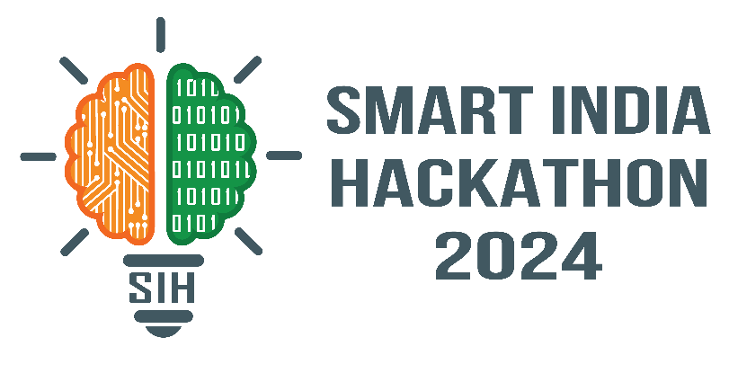
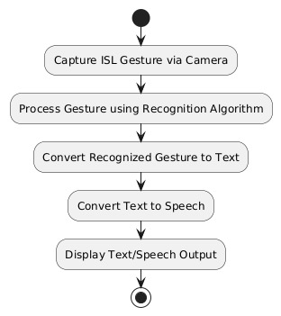
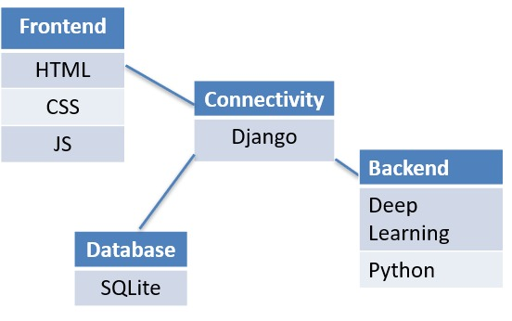
TECHNICAL APPROACH
Logicode
FLOWCHART:-
Technologies to be used :-
3

Slide 4
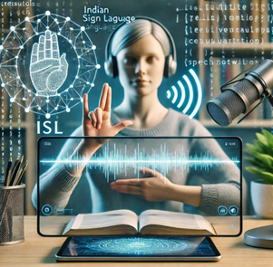
FEASIBILITY AND VIABILITY
Logicode
Analysis of the feasibility of the idea:-
Technical Feasibility: Uses deep learning and computer vision, ensuring scalability and smooth integration.
Economic Feasibility: Revenue from subscriptions, licensing, and government support makes it viable.
Operational Feasibility: Real-time adaptation and expert collaboration enhance accuracy and usability.
Legal and Ethical Feasibility: Ensures data privacy compliance and bias-free AI models for fairness.
Market Feasibility: High demand for assistive tech fills a gap in ISL translation solutions.
Strategies for overcoming these challenges
Enhancing Accuracy: Train deep learning models with diverse datasets to improve gesture recognition.
Cost Management: Use open-source tools and seek government or NGO funding for accessibility projects.
Scalability: Optimize models for offline use and enable integration with multiple platforms like mobile apps and smart devices.
@SIH Idea submission- Template
4
Notes:
1.7.2013
1.7.2013
1.7.2013
4
‹#›
‹#›
‹#›

Slide 5

IMPACT AND BENEFITS
Logicode
Potential impact on the target audience
Improve communication between the Deaf and Mute person.
It bridges gap between normal, Impaired person.
Empower Deaf and Mute community.
Social integration.
Increase Accessibility.
Benefits of the solution
Reduces the isolation of deaf and mute individuals.
Employment opportunities for deaf or mute community.
Helpful for families, friend.
Cost efficient.
Digital Accessibility.
@SIH Idea submission- Template
5
Notes:
1.7.2013
1.7.2013
1.7.2013
5
‹#›
‹#›
‹#›

Slide 6
Logicode
RESEARCH AND REFERENCES
References:
YouTube: https://youtube.com/playlist?list=PLZoTAELRMXVPGU70ZGsckrMdr0FteeRUi&si=pZXz3rcByYyFW_oB
2. Dataset : https://universe.roboflow.com/niladri-basu-roy-qnrm4/indian-sign-language-detection/dataset/2
@SIH Idea submission- Template
6
Notes:
1.7.2013
1.7.2013
1.7.2013
6
‹#›
‹#›
‹#›

